Slide 1

Comprehensive Information Integration Modeling Framework for Video Titling
KDD 2020 oral
Presented by Ju Xin

Slide 2
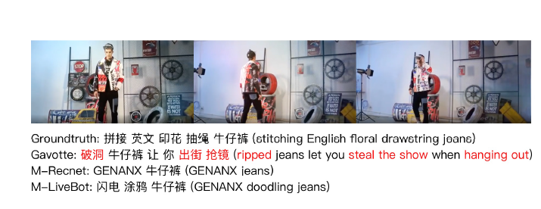
背景
在视频推荐任务中，给淘宝视频起一个新颖恰当的题目有益于吸引用户的注意力。

Slide 3

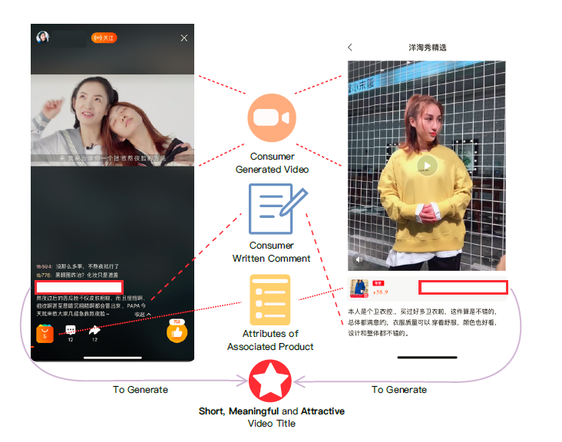
Idea
the visual spatial-temporal dynamics in the video
the narrative description in commentary sentences
the human-nameable aspects of products.
多模态

Slide 4
挑战与创新点
挑战
现有模型fail to recognize the distinguishing features of products as well as the dynamic change of fine-grained landmarks, i.e., different key-points of products
多模态特征融合
贡献：
devise a new learning schema for general video captioning by employing the flexible GNNs and the hierarchical video modeling processes
Global local Aggregation module to capture the inter-actions across heterogeneous graphs and aggregate them into a holistic representation.

Slide 5
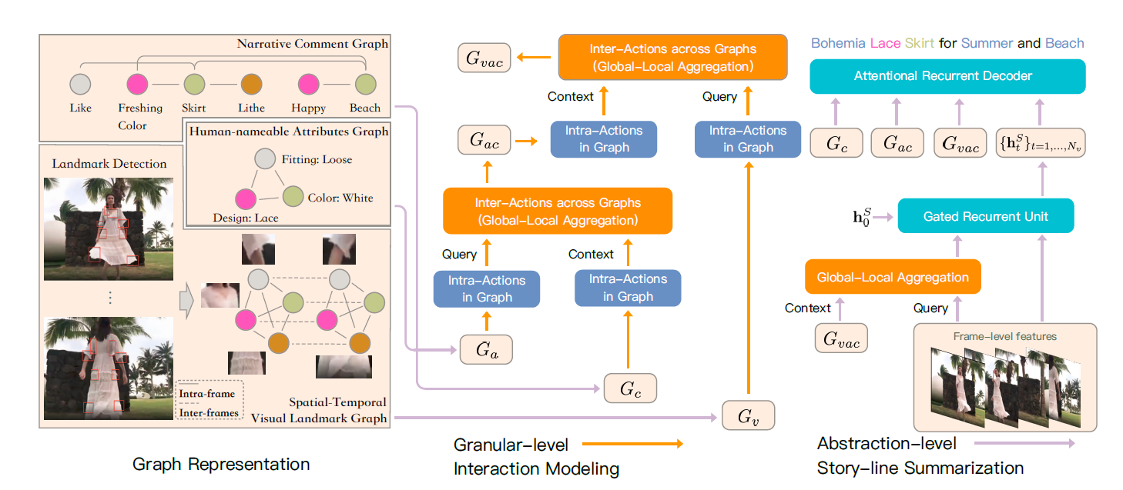
模型
特征表达
多模态特征融合
Title生成

Slide 6
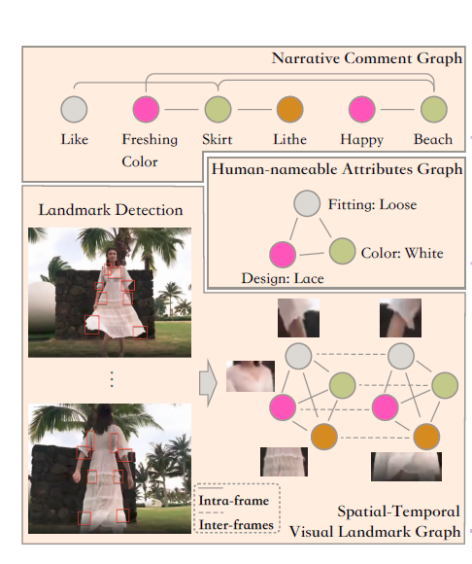





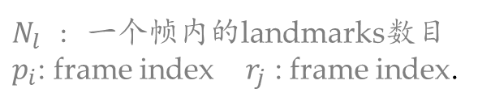
模型
capture long-range temporal dependencies and the high-order relationships
Graph Representations
相关word被连在一块
Video Landmark Graph – $G_{V}$
Narrative Comment Graph – $G_{C}$
Attributes Graph - $G_{a}$
Edge weights
$N_{l}$ : 一个帧内的landmarks数目
$p_{i}$: frame index $r_{j}$ : frame index.
$$W_{d} :\text{the} \text{similarity}$$

Slide 7
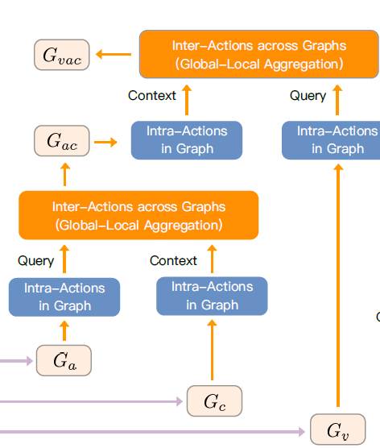
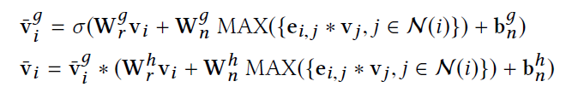

模型
Granular-level Interaction Modeling(粒度级)
Information propagation
gate vector ${\tilde{v}}_{i}^{g}$: control how much information is needed
Global-local Aggregation
Global gated access
Local attention
Aggregating three graphs

Slide 8
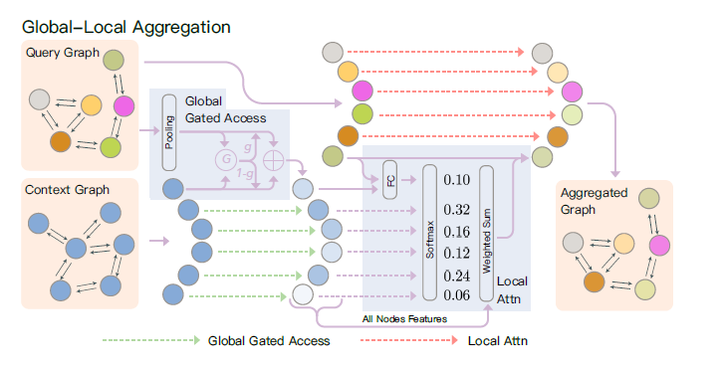
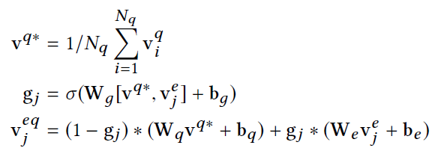
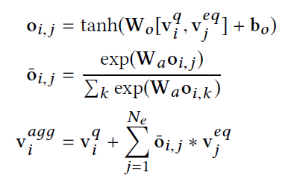

模型
Granular-level Interaction Modeling
Information propagation
Global-local Aggregation
input: query graph $G_{q}={\left\{v_{i}^{q}\right\}}_{i=1…N_{q}}$ context graph $G_{e}$
Global gated access
globally relevant information
Local attention
further filter important features related to each individual query node
Aggregating three graphs

Slide 9
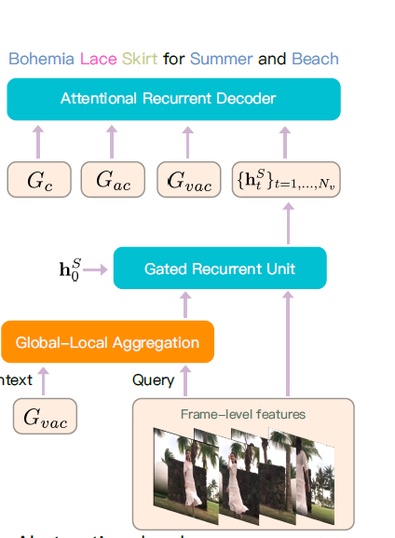




模型
Abstraction-level Story-line Summarization
aggregated feature sequence
$X={\{x_{t}\}}_{t=1…N_{v}}$: the frame-level features
Decoder
$h_{m}^{D}$ : decoder hidden state $f_{la}$: local attention mechanism
${\hat{c}}_{m}$ : previously predicted word

Slide 10






模型训练
Cross-Entropy Loss minimize the cross-entropy loss at each decoder step
$f_{p}(c_{m}^{R})$ the predicted probability of word $c_{m}^{R}$ at timestamp m.
probability distribution:
Generation Coverage Loss directly penalize the repetitive predicted words
coverage vector $ς$
Final loss

Slide 11
实验
预测能力
对比实验
M-MPLSTM M-S2VT RNN models
M-RecNet M-SALSTM attention-based RNN
M-LiveBot transformer-based
M-HRNE hierarchical design
指标
Reference-based metrics
BLEU4 , METEOR , ROUGE_L , CIDEr
Retrieval-based metrics
Recall, MRR
数据集
T-VTD: 90,000 <video, comment, attributes, title> quadruples and each contains a product-oriented video stream from Mobile Taobao

Slide 12
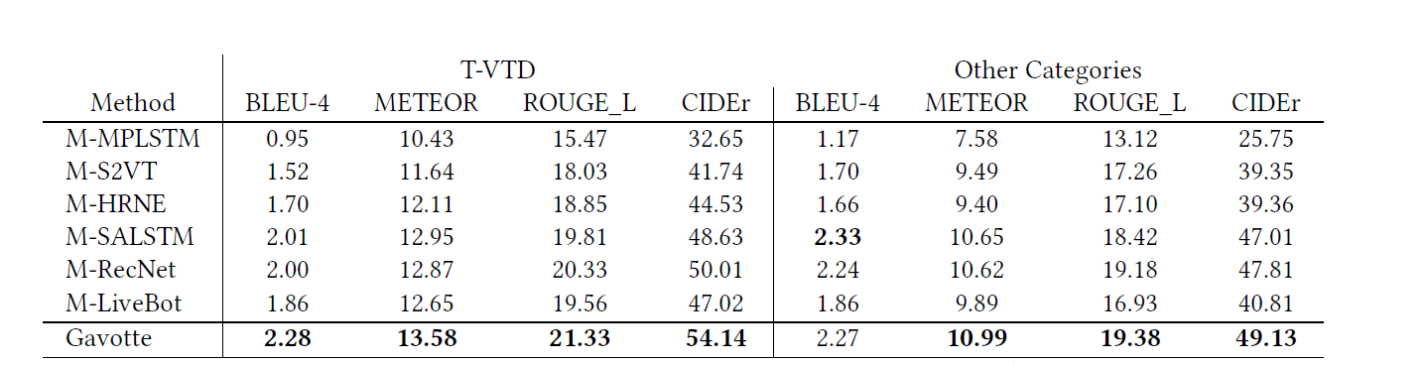
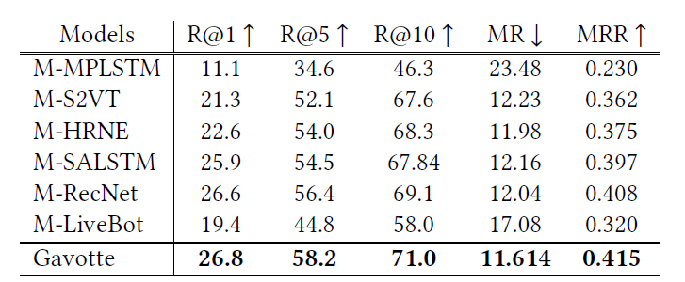
实验
对比实验 性能分析
Reference-based metrics
three categories, i.e., toys, makeups, and kitchen tools.
Retrieval-based metrics

Slide 13
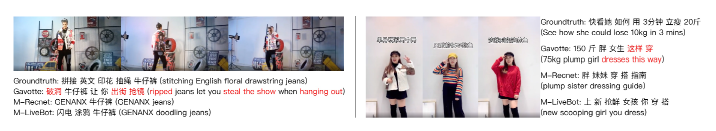
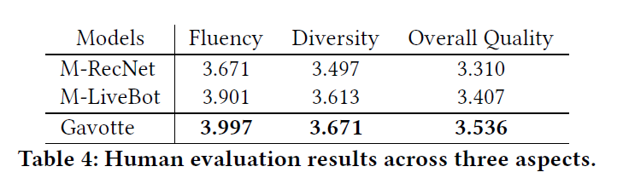
实验
对比实验
Workers are required to first watch the video before reading the other inputs and titles.

Slide 14
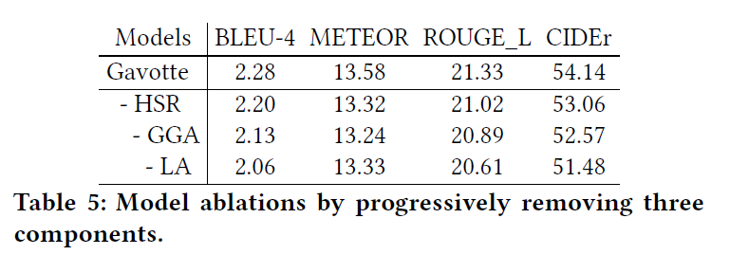
实验
对比实验
abstraction-level story-line summarization process :HSR
The gated global access :GGC
the local attention : LA

Slide 15
规格严格，功夫到家
感谢聆听指正

Slide 16
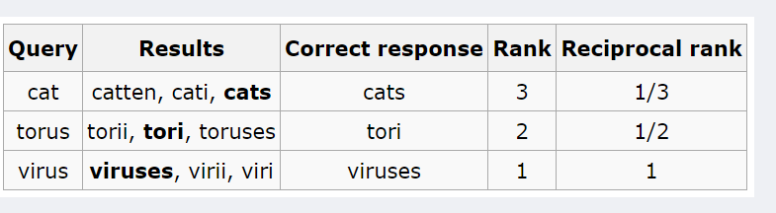
MRR
Mean Reciprocal Rank(MRR)正确检索结果值在检索结果中的排名来评估检索系统的性能。
其中， 是对于第i个用户，推荐列表中第一个在ground-truth结果中的item所在的排列位置。举个例子：假如检索三次的结果如下，需要的结果（cat，torus，virus）分别排在3,2,1的话，此系统地MRR为（1/3 + 1/2 + 1)/3 = 11/18
如果检索出来的正确结果多于一个时，可以使用MAP（Mean Average Precision）算法

Slide 17


BLEU
首先引入BP值，作者指定当待评价译文同任意一个参考译文长度相等或超过参考译文长度时，BP值为1，当待评价译文的长度较短时，则用一个算法得出BP值。以c来表示待评价译文的长度，r来表示参考译文的文字长度，则

